Slide 1
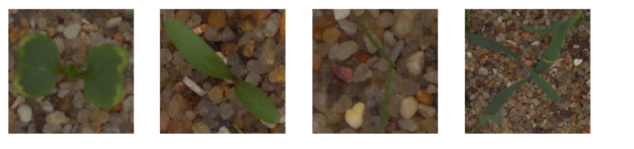
Plant Seedlings Classification
Using Transfer Learning

Slide 2
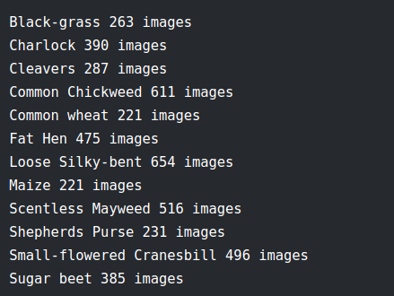
Plant Seedlings Classification - Description
Classify the type of a plant seedling
The data used for training consists of images of plant seedling taking from various angles, and is divided to 12 types (classes) as follows:
There is also a test file consisting of 794 images that we run our models on it and submit a csv file with label of each image to the kaggle competition site and get our score on this test images.

Slide 3
This is a classification problem where upon a given image, we need to classify it to one of the 12 classes. So we will use a Convolution Neural Network for the task.
It is almost practically inefficient to train a Convolution Neural Network from scratch.
So, we take the weights of a pre trained CNN model on ImageNet with 1000 classes and keep the top layers frozen and replacing the last prediction layer with a dense layer consisting of 12 nodes instead of 1000 and train on only this last layer.
This is because the top layers learn simple basic general features and we need not to train those layers and this pre-training can be directly applied to our task.
This process is called transfer learning.

Slide 4
What is transfer learning ?
Transfer learning takes what a model learned while solving one problem and applies it to a new application.
Early layers of a deep learning model identify simple shapes, later layers identify more complex visual patterns and the very last layer makes predictions.
Most layers from a pre trained model are useful in new applications because most computer vision problems involve similar low-level visual patterns

Slide 5
In our problem…
We’ll reuse all of the pre trained model and just replace the final layer that was used to make prediction.
Some layers before the last layer in the pre trained that was trained on the ImageNet dataset, may identify features in our image dataset.
We will drop in a replacement for the last layer in the pre trained model, this new last layer will predict to which class of 12 plant seedlings an image belongs to, based on the result of the previous layer.

Slide 6
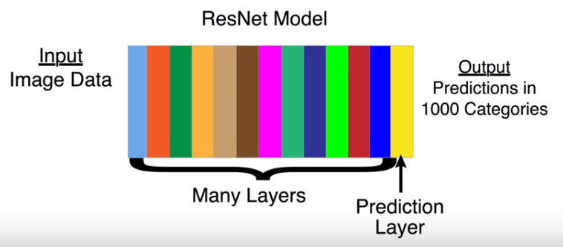
A closer look (Resnet example)

Slide 7
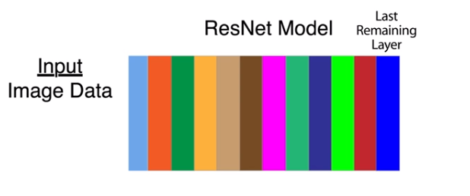
We cut off the last layer, the last layer of what’s left has information about our photo content stored as a series of numbers in a tensor. It is a one-dimensional tensor i.e a vector.

Slide 8

The image feature vector or the 'Bottleneck'
'Bottleneck' is an informal term often used for the layer just before the final output layer that actually does the classification.
This penultimate layer has been trained to output a set of values that's good enough for the classifier to use to distinguish between all the classes it's been asked to recognize.
That means it has to be a meaningful and compact summary of the images, since it has to contain enough information for the classifier to make a good choice on a very small set of values.
The reason our final layer retraining can work on new classes is that it turns out the kind of information needed to distinguish between all the 1,000 classes in ImageNet is often also useful to distinguish between new kinds of objects.

Slide 9
Newly added classification layer
We want to classify the image into 12 categories.
After the last layer we keep the pre-trained model, we add a new layer with 12 nodes, a node for every category.
Any node in the last layer before prediction might inform how much an image belongs to a certain category, so the measure of how much an image belongs to a certain category depends on all the nodes in this layer, this why the newly added layer is a dense (fully-connected) layer where each node in the new layer is connected to all the nodes in the last remaining layer in the pre-trained model.
The structure would be as follows in the next slide.

Slide 10
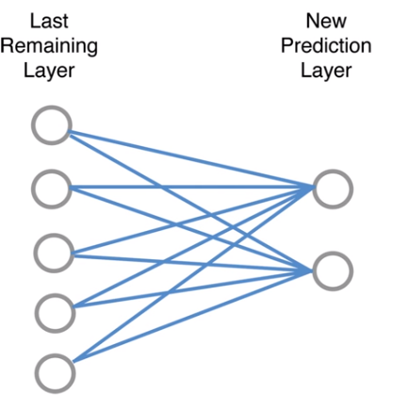
The structure is drawn for two nodes alone but can be generalized for 12 nodes

Slide 11
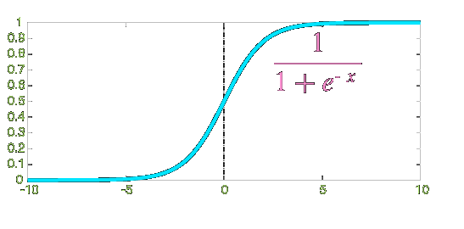
For all the connection drawn in the previous slide we’ll use training data to determine which nodes suggest which category an image belongs to.
That is we’ll use the training data to train the last layer of the model.
The training data will be photos that are labeled by each category of the 12 categories.
We allow all features from the last remaining layer to influence or be connected with prediction layer i.e the last newly added layer is a dense layer (fully-connected).
At the newly added layer we’ll get a score for each category and then apply a function called softmax.
The softmax function will transform the scores to probabilities so they’ll all be positive and will sum to one.

Slide 12
Our implementation

Slide 13
Train validation split
Our data consists of 4750 images divides into 12 classes (see slide 2)
Using the code in split.py we divided it so that the training images would be 80% and the validation images 20%
We shuffled the images in each category before splitting it so that the validation images would be sampled as generally as possible.
At the end of this process we had two directories:
A directory called train for the training data that holds 3800 images (80% of all the images), divided into 12 categories represented by 12 subdirectory.
A directory called train for the training data that holds 950 images (20% of all the images), divided into 12 categories represented by 12 subdirectory.

Slide 14
The training code

Slide 15
Explaining the parameters and their chosen values.

Slide 16
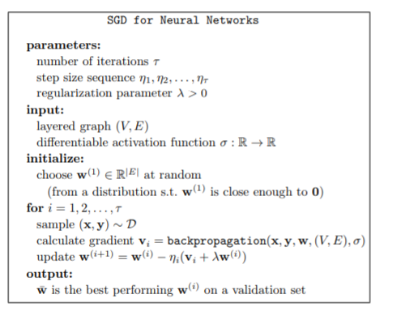
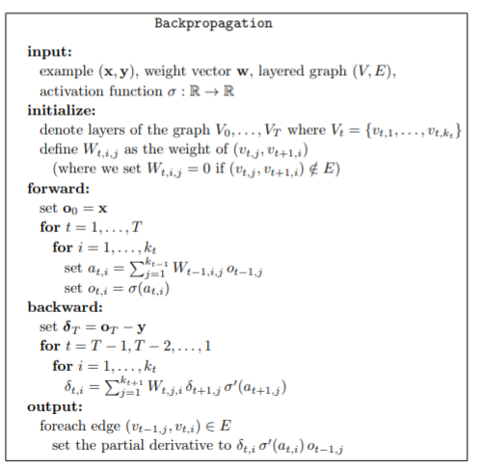

Slide 17
Intuitive explanation of SGD
We used stochastic gradient descent to set the weights that minimize our loss function.
stochastic gradient descent “feels” which direction goes downhill most steeply on the loss function (with regards to weights values) and take a step in that direction, then it “feels” around again to find which direction is downhill and it takes another step, it repeats this processes until it can’t go down anymore.
This is basically how gradient descent works, it looks at data and checks which weights it can change to get a little lower loss function and it changes the weights slightly in that direction then it repeats this to improve the weights slightly again.
How does it find which way it can change the weights to improve the loss function ? Basically how does it find which way goes downhill ? For that it uses backward propagation which calculates the gradient.

Slide 18
More details about SGD
It generally doesn’t use all of the data to calculate each step doing so would require a lot of calculations so it would be slow.
Instead it looks at some of the data at a time, the batch size is the number of images used to calculate each step.
It takes one small batch and then the next until it used all of the data.
One time through the data is called an epoch.
it incrementally improve weights for multiple epochs so each image would be used to improve weights more than once.
Backpropagation is the process by which we find out which way to change the weights at each step of gradient descent.

Slide 19
The learning rate and Adam optimizer
The size of weight changes is determined by the learning rate.
Low learning rates mean the model may take a long time training before it gets accurate, high learning rates mean the model may take huge steps around in a field always jumping over the best weights and never getting very accurate.
We used the Adam optimizer which is a special variation of gradient descent that automatically figures out the best learning rate throughout the gradient descent process.

Slide 20
Choosing the values of batch size for training images and validation images
Quoting the paper On Large-Batch Training for Deep Learning: Generalization Gap and Sharp Minima:
“It has been observed in practice that when using a larger batch there is a degradation in the quality of the model, as measured by its ability to generalize”
“large-batch methods tend to converge to sharp minimizers of the training and testing functions—and as is well known, sharp minima lead to poorer generalization. n. In contrast, small-batch methods consistently converge to flat minimizers, and our experiments support a commonly held view that this is due to the inherent noise in the gradient estimation.”
So we decided to stick with low batch size between 1-32

Slide 21
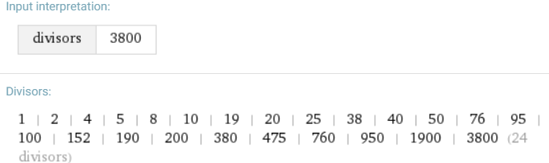
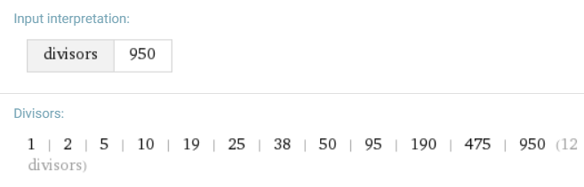
Choosing the values of batch size for training images and validation images
Our training data consists of 3800 images and we need to apply the following equation : 3800 = batch_size * steps_per_epch
Our validation data consists of 950 images and we need to apply the following equation : 950= batch_size * validation_steps.

Slide 22
Number of epochs and image size
The number of epochs was set to 10 as we saw the accuracy scores for the validation converges around that number.
The image size was chosen according to the default image size of the pre-trained model.

Slide 23
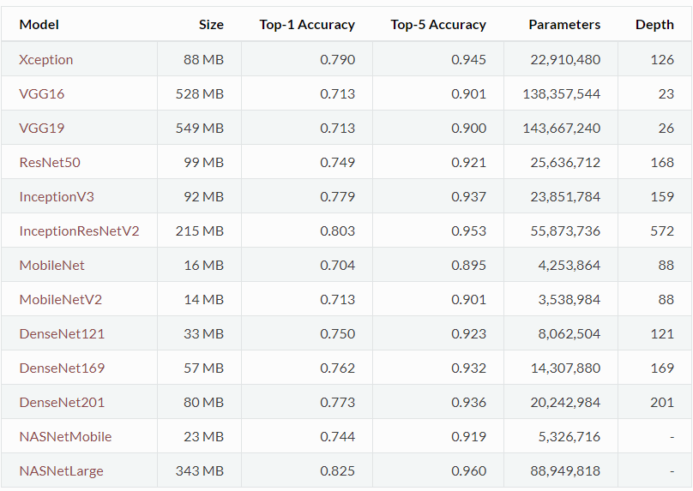
Results on different pre-trained models for the ImageNet competition.

Slide 24
Results

Slide 25
First we try the resnet50 model on different batch sizes so we can decide on the best batch size to use.

Slide 26
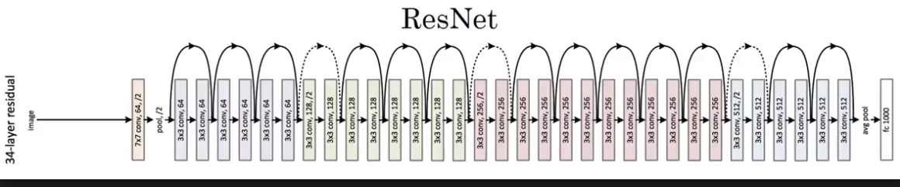
Resnet 50 The default input size for this model is 224x224.

Slide 27
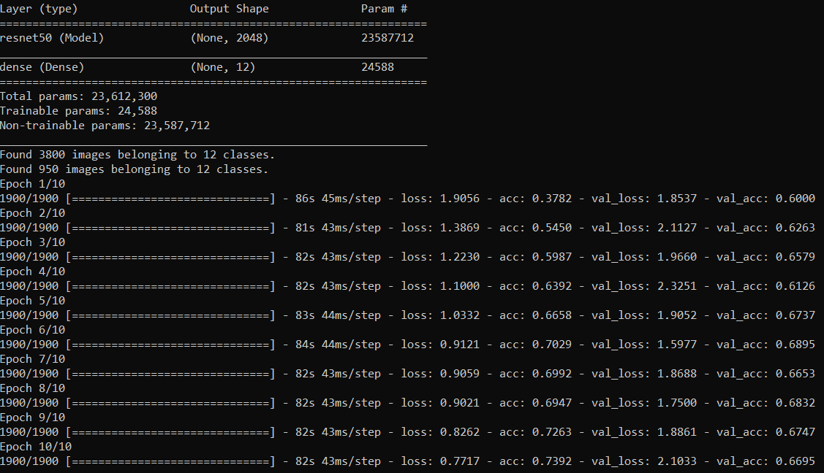
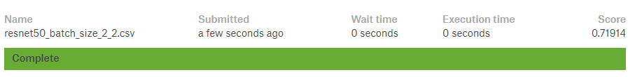
Resnet 50 with train batch size = 2, validation batch size = 2, steps per epoch = 1900, validation steps = 475, epochs = 10

Slide 28
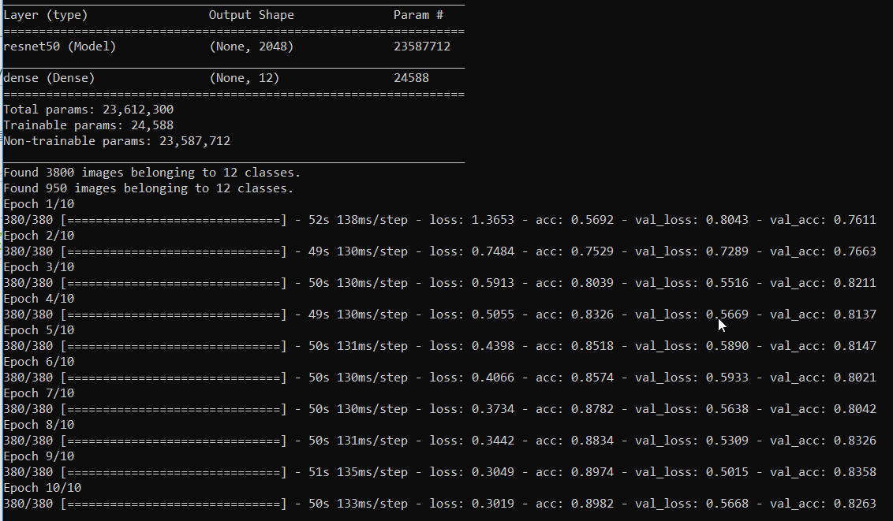
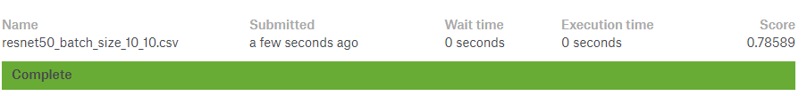
Resnet 50 with train batch size = 10, validation batch size = 10, steps per epoch = 380, validation steps = 95, epochs = 10

Slide 29
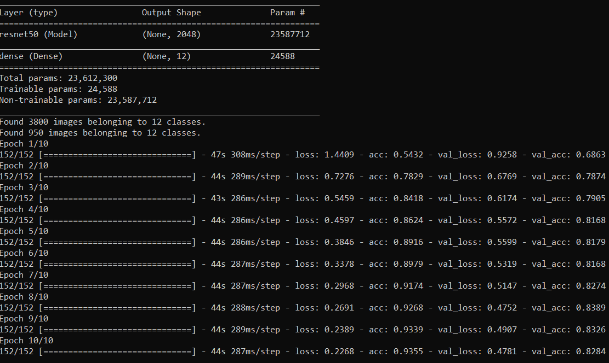
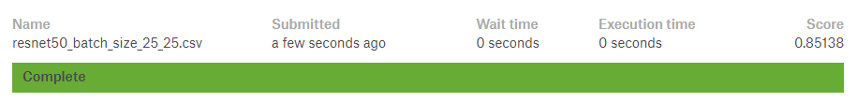
Resnet 50 with train batch size = 25, validation batch size = 25, steps per epoch = 152, validation steps = 38, epochs = 10

Slide 30
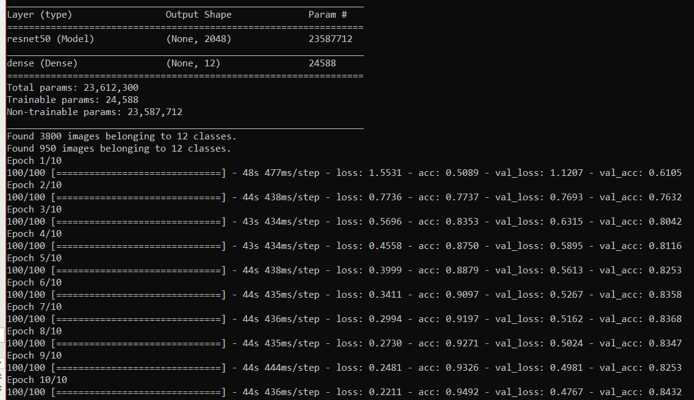
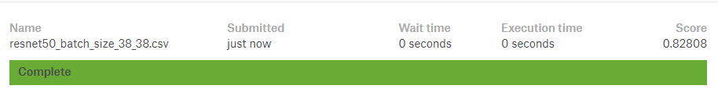
Resnet 50 with train batch size = 38, validation batch size = 38, steps per epoch = 100, validation steps = 25, epochs = 10

Slide 31
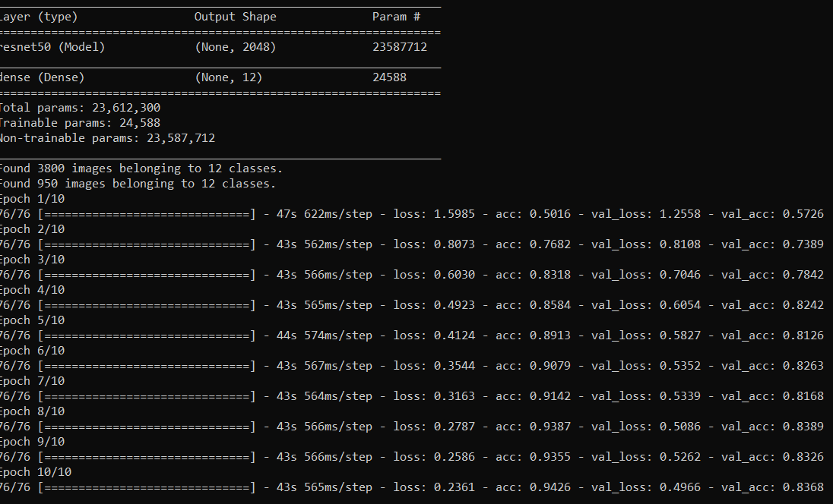
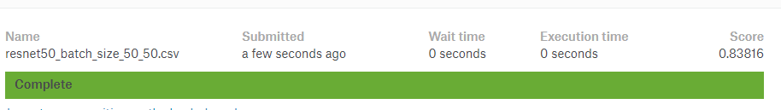
Resnet 50 with train batch size = 50, validation batch size = 50, steps per epoch = 76, validation steps = 19, epochs = 10

Slide 32


Resnet50 with default values: train batch size = 32, validation batch size = 32, steps per epoch = 200, validation steps = 1, epochs = 10 no preservation of the equation ,3800 = batch_size * steps_per_epch or 950= batch_size * validation_steps

Slide 33
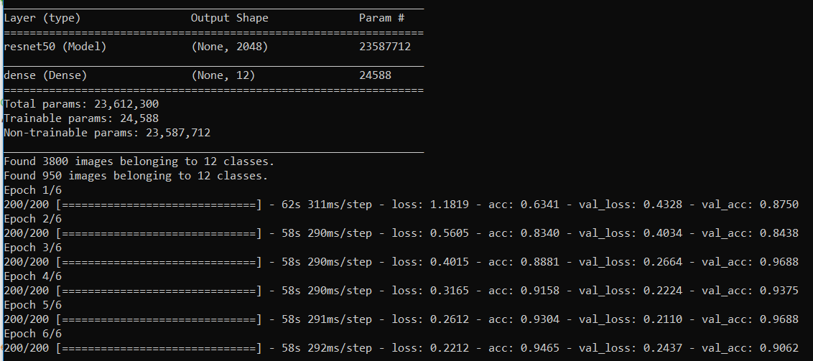
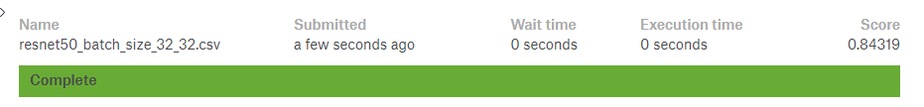
Maybe we are overfitting, so we tried less number of epochs, train batch size = 32, validation batch size = 32, steps per epoch = 200, validation steps = 1, epochs = 6 no preservation of the equation ,3800 = batch_size * steps_per_epch or 950= batch_size * validation_steps

Slide 34
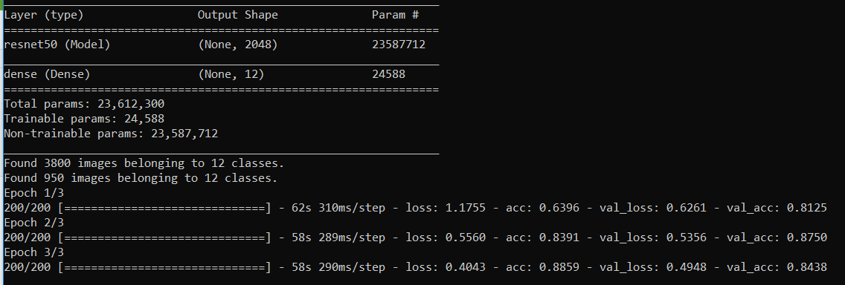
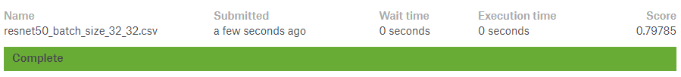
Maybe we are overfitting, so we tried less number of epochs, train batch size = 32, validation batch size = 32, steps per epoch = 200, validation steps = 1, epochs = 3 no preservation of the equation ,3800 = batch_size * steps_per_epch or 950= batch_size * validation_steps

Slide 35
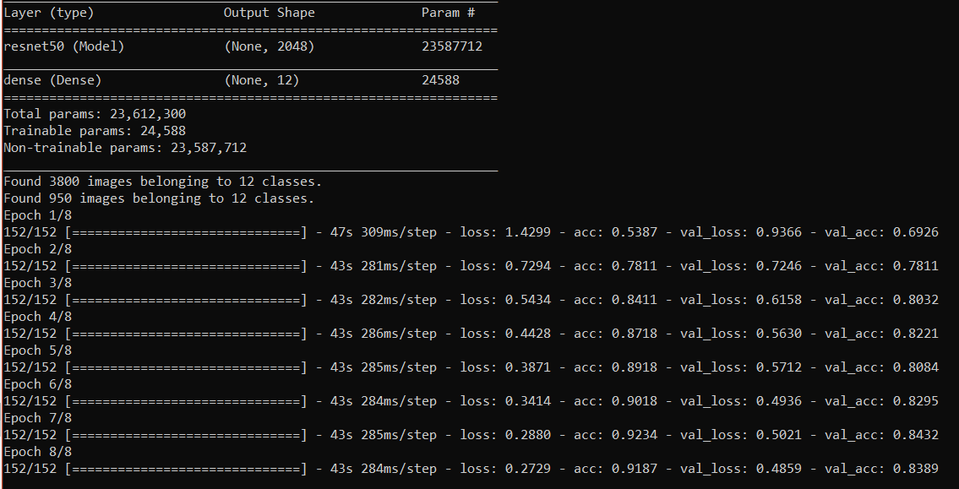
Best result is :Resnet 50 with train batch size = 25, validation batch size = 25, steps per epoch = 152, validation steps = 38, epochs = 10
We will try with same parameters, with less epochs in case we are overfitting.
With epochs = 8 we got:

Slide 36
Still the best result is Resnet 50 with train batch size = 25, validation batch size = 25, steps per epoch = 152, validation steps = 38, epochs = 10
From now on we use these parameters and try on different pre-trained models on ImageNet.

Slide 37
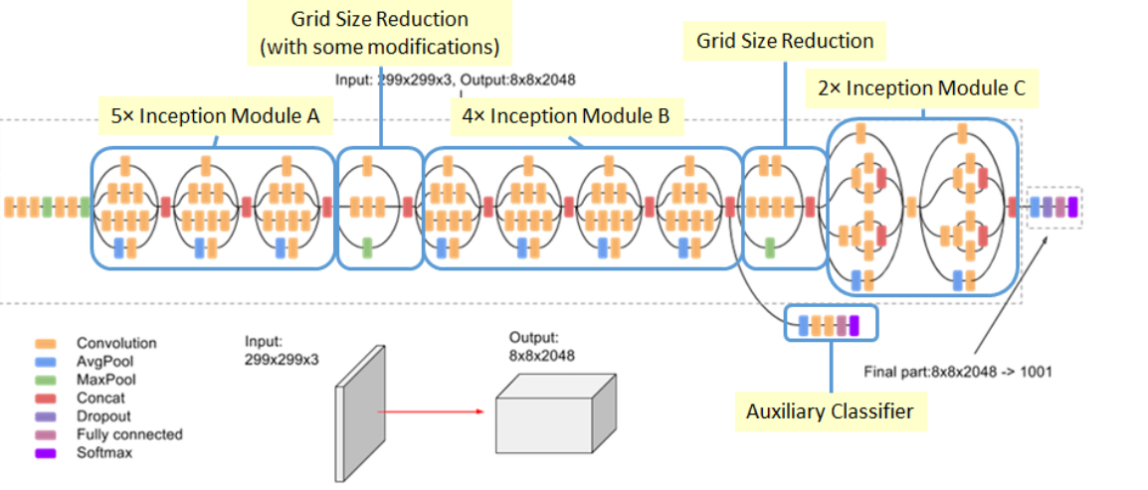
InceptionV3 The default input size for this model is 299x299.

Slide 38
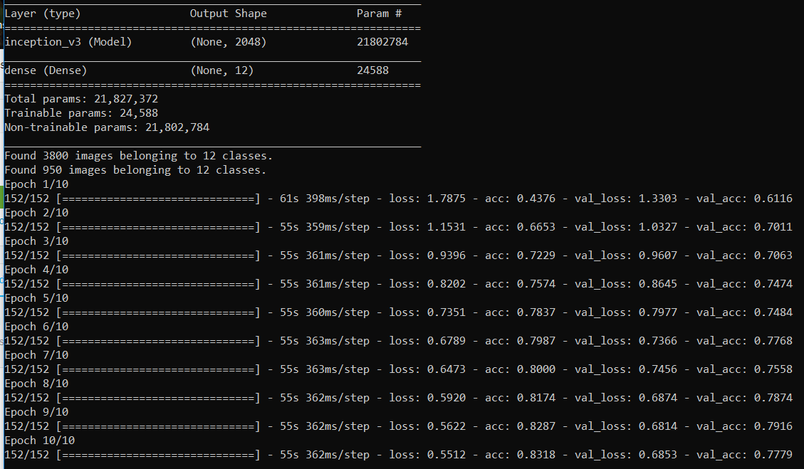
InceptionV3with train batch size = 25, validation batch size = 25, steps per epoch = 152, validation steps = 38, epochs = 10

Slide 39
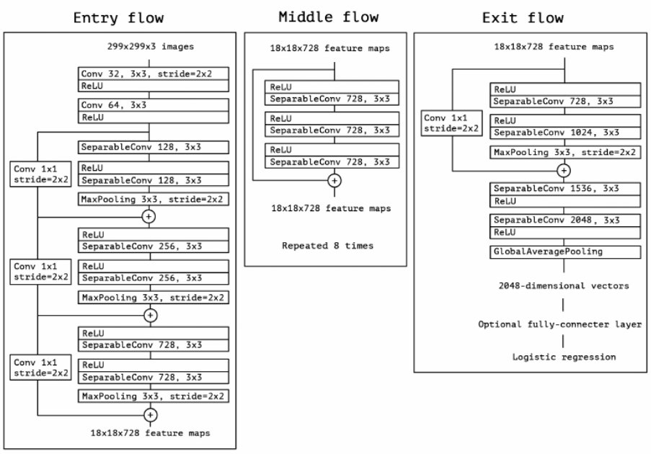
Xception The default input size for this model is 299x299

Slide 40
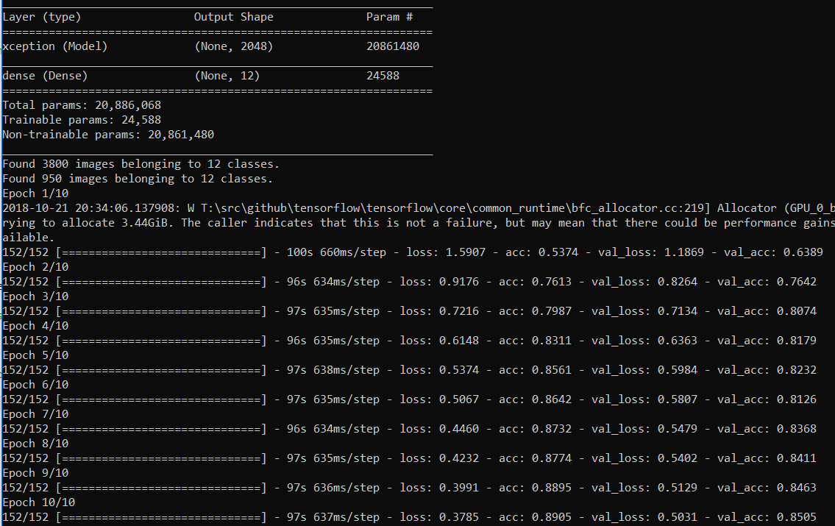
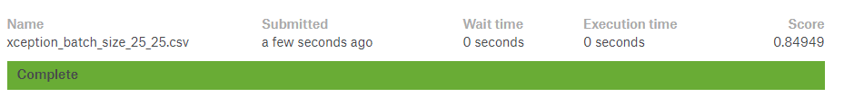
Xception with train batch size = 25, validation batch size = 25, steps per epoch = 152, validation steps = 38, epochs = 10

Slide 41
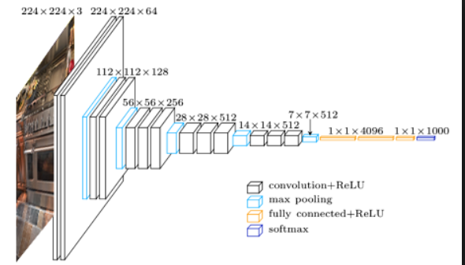
VGG16 The default input size for this model is 224x224

Slide 42
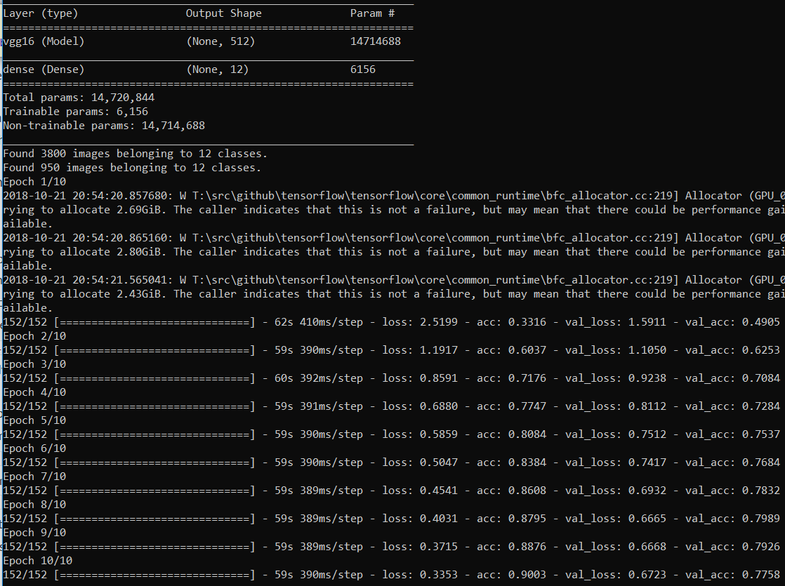
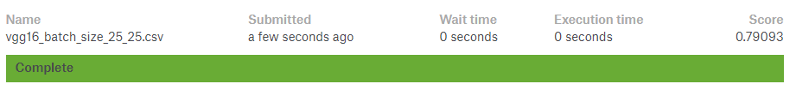
VGG16 with train batch size = 25, validation batch size = 25, steps per epoch = 152, validation steps = 38, epochs = 10

Slide 43
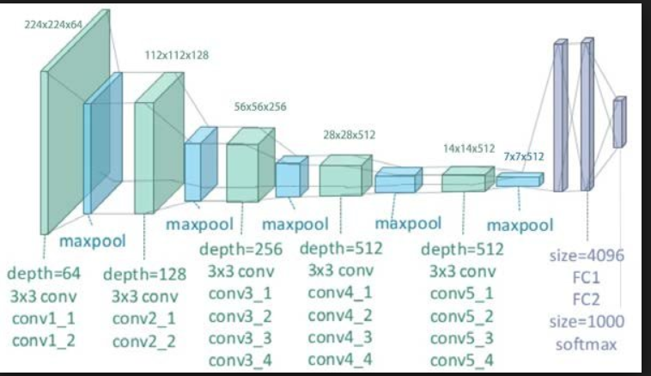
VGG19 The default input size for this model is 224x224

Slide 44
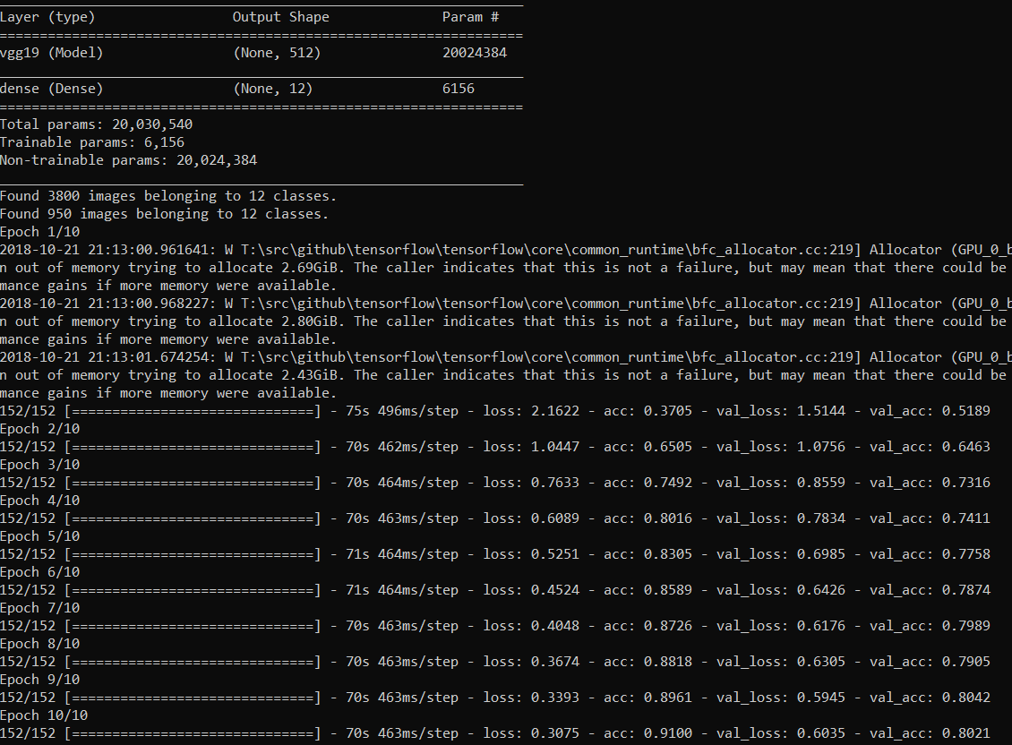
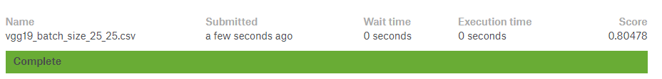
VGG19 with train batch size = 25, validation batch size = 25, steps per epoch = 152, validation steps = 38, epochs = 10

Slide 45
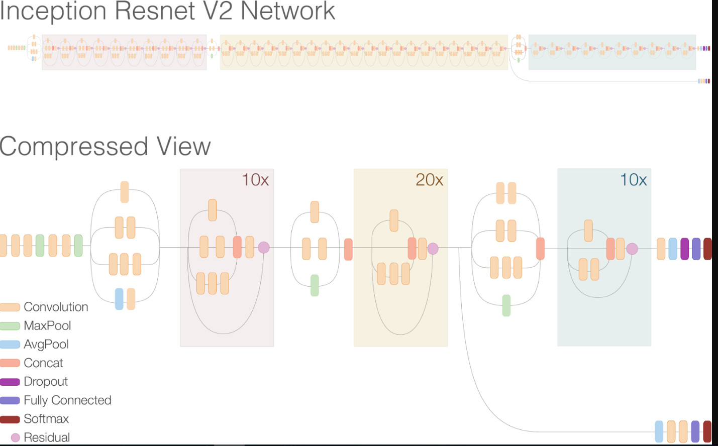
InceptionResNetV2 The default input size for this model is 299x299

Slide 46
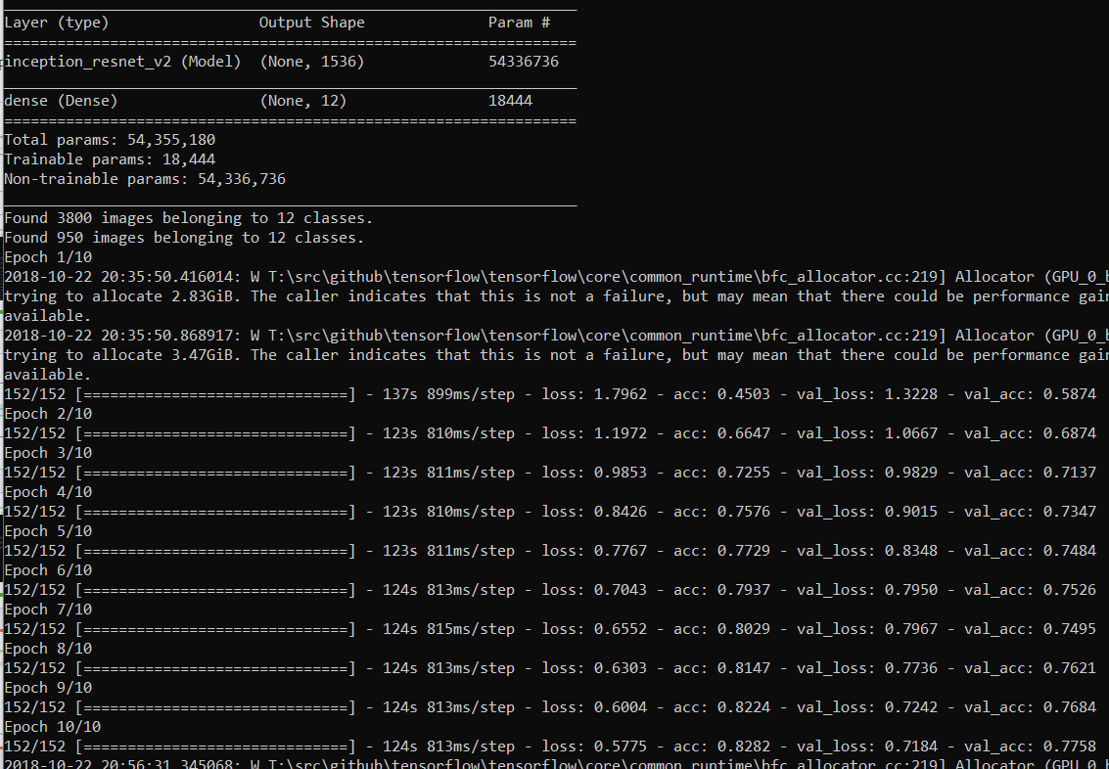
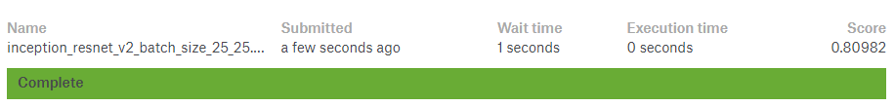
InceptionResNetV2 with train batch size = 25, validation batch size = 25, steps per epoch = 152, validation steps = 38, epochs = 10

Slide 47
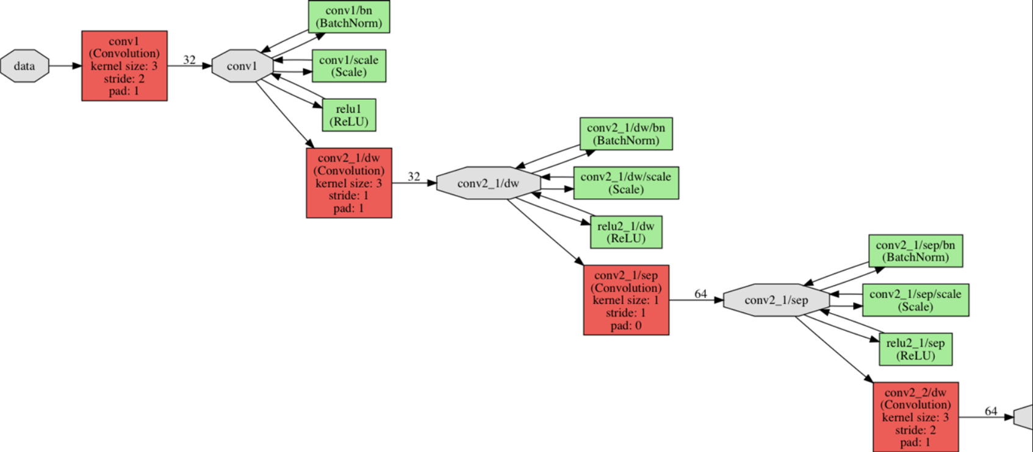
MobileNet The default input size for this model is 224x224

Slide 48
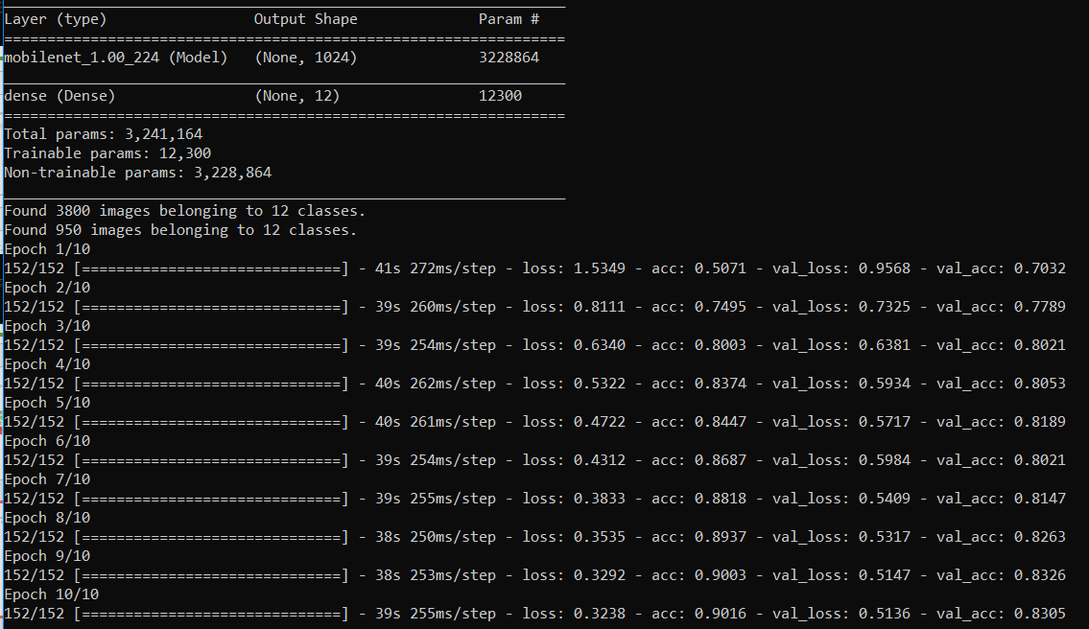

MobileNet with train batch size = 25, validation batch size = 25, steps per epoch = 152, validation steps = 38, epochs = 10

Slide 49
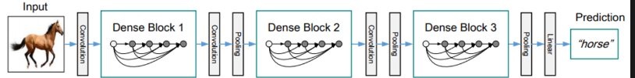
DenseNet121 The default input size for this model is 224x224

Slide 50
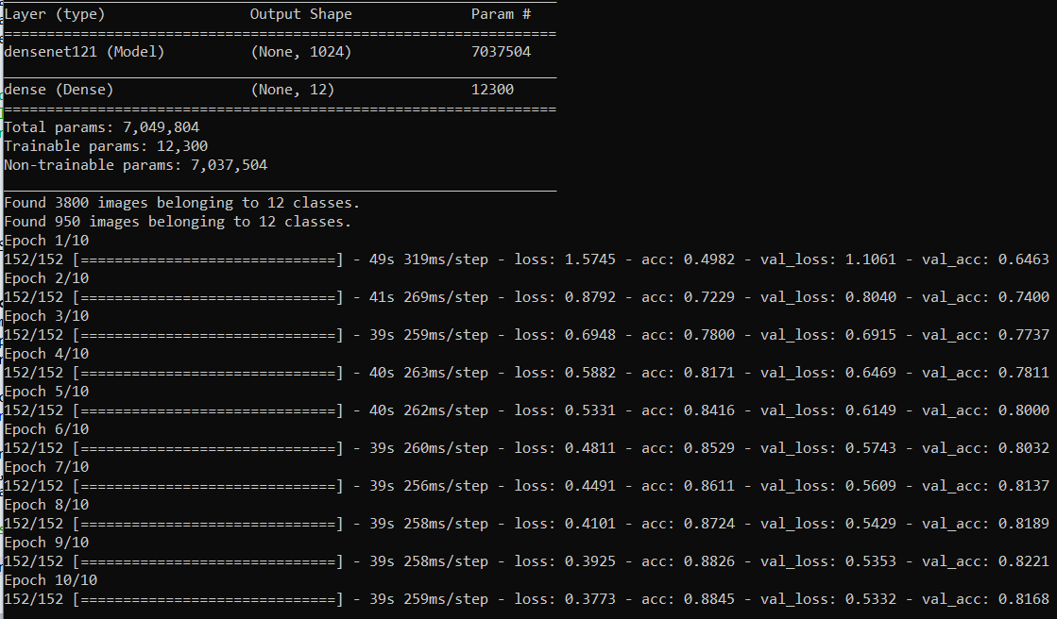
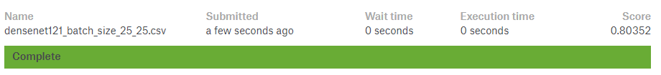
DenseNet121 with train batch size = 25, validation batch size = 25, steps per epoch = 152, validation steps = 38, epochs = 10

Slide 51
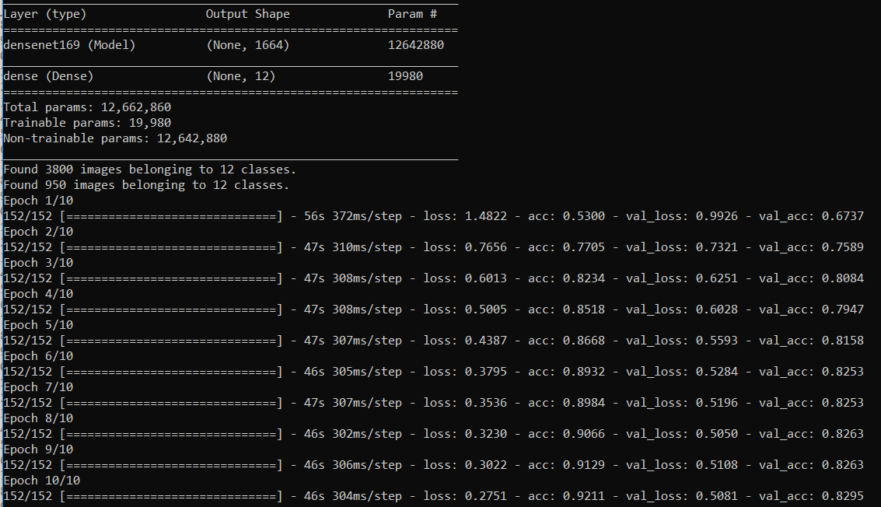
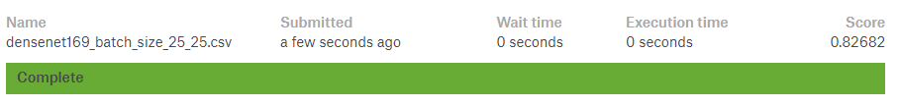
DenseNet169 with train batch size = 25, validation batch size = 25, steps per epoch = 152, validation steps = 38, epochs = 10

Slide 52
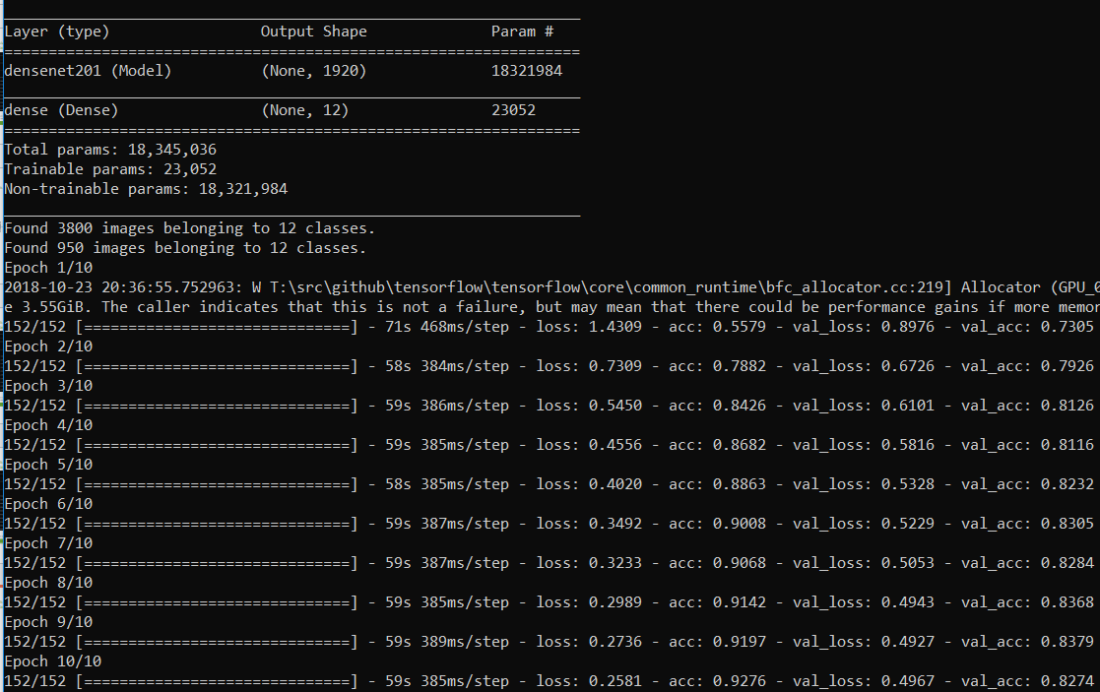
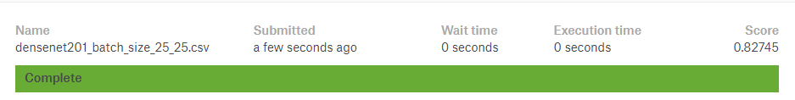
DenseNet201 with train batch size = 25, validation batch size = 25, steps per epoch = 152, validation steps = 38, epochs = 10

Slide 53

NASNetMobil The default input size for this model is 224x224

Slide 54


NASNetMobil with train batch size = 25, validation batch size = 25, steps per epoch = 152, validation steps = 38, epochs = 10

Slide 55


NASNetLarge with train batch size = 25, validation batch size = 25, steps per epoch = 152, validation steps = 38, epochs = 10

Slide 56
Still the best result on test data is Resnet 50 with train batch size = 25, validation batch size = 25, steps per epoch = 152, validation steps = 38, epochs = 10

Slide 57
Trying some data augmentation

Slide 58


Resnet 50 with train batch size = 25, validation batch size = 25, steps per epoch = 152, validation steps = 38, epochs = 10 data augmentation :(horizontal_flip=True, width_shift_range = 0.2, height_shift_range = 0.2)

Slide 59


Resnet 50 with train batch size = 25, validation batch size = 25, steps per epoch = 152, validation steps = 38, epochs = 10 data augmentation :(rotation_range=20, width_shift_range=.2, height_shift_range=.2, shear_range=0.2, zoom_range=0.2, channel_shift_range=1, horizontal_flip=True, vertical_flip=False)

Slide 60


Resnet 50 with train batch size = 25, validation batch size = 25, steps per epoch = 152, validation steps = 38, epochs = 20 data augmentation :(rotation_range=20, width_shift_range=.2, height_shift_range=.2, shear_range=0.2, zoom_range=0.2, channel_shift_range=1, horizontal_flip=True, vertical_flip=False)

Slide 61
Best result on test data:
Resnet 50 with train batch size = 25, validation batch size = 25, steps per epoch = 152, validation steps = 38, epochs = 10 data augmentation :(horizontal_flip=True, width_shift_range = 0.2, height_shift_range = 0.2)

Slide 62

Summary of results in a table

Slide 63
Sources:
On Large-Batch Training for Deep Learning: Generalization Gap and Sharp Minima
Kaggle tutorial on Transfer Learning.

